Slide 1
OBJ to binary structure
File structure
V1.1
G. Dumitra

Slide 2
History
version | changes
1.0 | Define OBJ structure
1.1 | Define MTL structure

Slide 3
Summary
How to export from Blender to OBJ
Internal file structure
MTL structure
Known limitations: MTL structure
OBJ structure

Slide 4
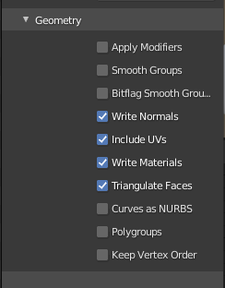
How to export from Blender to OBJ
In order to have the OBJ and MTL files compatible with this parser you need to export from Blender with the triangulate faces option check!

Slide 5
Internal file structure
MTL Information Array of Material(s)
Array of materials
Array of Face(s) (triangles)
Array of vertices

Slide 6
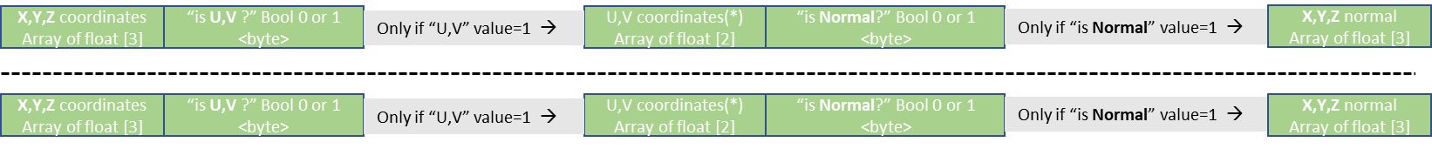
Internal file structure: more details
MTL Information Array of Material(s)
No of materials <signed int>
Array of materials
Material name
<array of signed chars>
No of chars <short>
“is KA ?” Bool 0 or 1 <byte>
X,Y,Z coordinates
Array of float [3]
Array of Face(s) (triangles)
MTL ID
1..n
Items no.
Array of vertices
MTL ID
1..n
Items no.

Slide 7
Array of materials: MTL structure
No of materials <signed int>
0
Material name
<array of signed chars>
No of chars <short>
“is KA ?” Bool 0 or 1 <byte>
X,Y,Z coordinates
Array of float [3]
“is KD ?” Bool 0 or 1 <byte>
X,Y,Z coordinates
Array of float [3]
“is KS ?” Bool 0 or 1 <byte>
X,Y,Z coordinates
Array of float [3]
“is KE ?” Bool 0 or 1 <byte>
X,Y,Z coordinates
Array of float [3]
One material unit
Ns <float>; “-1” => not available
Ni <float>; “-1” => not available
d <float>; “-1” => not available
illum <byte>; “-1” => not available
Map_ka file name
<array of signed chars>
No of chars <short>
Map_kd file name
<array of signed chars>
No of chars <short>
Map_ks file name
<array of signed chars>
No of chars <short>
Map_ns file name
<array of signed chars>
No of chars <short>
Map_d file name
<array of signed chars>
No of chars <short>
M-1 (next page)

Slide 8
M-1
Material name
<array of signed chars>
No of chars <short>
“is KA ?” Bool 0 or 1 <byte>
X,Y,Z coordinates
Array of float [3]
The material will be added in order from 0 to M-1 materials. Meaning there will be “M” materials.
When deserialize keep this order as each material into this array is referenced inside the OBJ.
For example if you have an OBJ with = 5 you have to load for that object the MTL[5]
MTL material ID (or -1 in case of none) <signed short>
See page 9

Slide 9
Array of faces: OBJ structure
See page 8
Obj name
<array of signed chars>
No of chars <signed int>
MTL material ID (or -1 in case of none) <signed short>
No of triangles/faces units <signed int>
X,Y,Z coordinates
Array of float [3]
“is U,V ?” Bool 0 or 1 <byte>
Only if “U,V” value=1 →
U,V coordinates(*)
Array of float [2]
“is Normal?” Bool 0 or 1 <byte>
Only if “is Normal” value=1 →
X,Y,Z normal
Array of float [3]
X,Y,Z coordinates
Array of float [3]
“is U,V ?” Bool 0 or 1 <byte>
Only if “U,V” value=1 →
U,V coordinates(*)
Array of float [2]
“is Normal?” Bool 0 or 1 <byte>
Only if “is Normal” value=1 →
X,Y,Z normal
Array of float [3]
Obj name
<array of signed chars>
No of chars <short>

Slide 10
Known limitations: MTL structure
Map_ka, map_kd are supported without “options”:
OK => “map_Ka mapfile.png”
NOK => “map_Ka -s 1 1 1 -o 0 0 0 -mm 0 1 chrome.mpc” (program will crash!)
Options that are not supported (according to http://paulbourke.net/dataformats/mtl/ )
-blendu on | off
-blendv on | off
-cc on | off
-clamp on | off
-mm base gain
-o u v w
-s u v w
-t u v w
-texres value
2. All strings are US-ASCII

Slide 11
Example
Take as an example the already serialized file “/examples/cube_output.bin”

Slide 12
Structure Example:
According to the definition of the file structure from page 5, we are looking first for the number of materials used by the object.
The file starts as:
No of materials <signed int>
This means we have 2 materials we shall load into memory.

